Slide 1
Neural Networks From Scratch Pt. 3
Review, Optimization, Derivatives, Backpropagation
Robert Moseley
California Baptist University
College of Engineering

Slide 2


My setup
Register for a student license
https://www.jetbrains.com/community/education/#students
I use Jupyter Notebooks for the coding (just a file type)
Google CoLab is another great option!
https://colab.research.google.com/

Slide 3
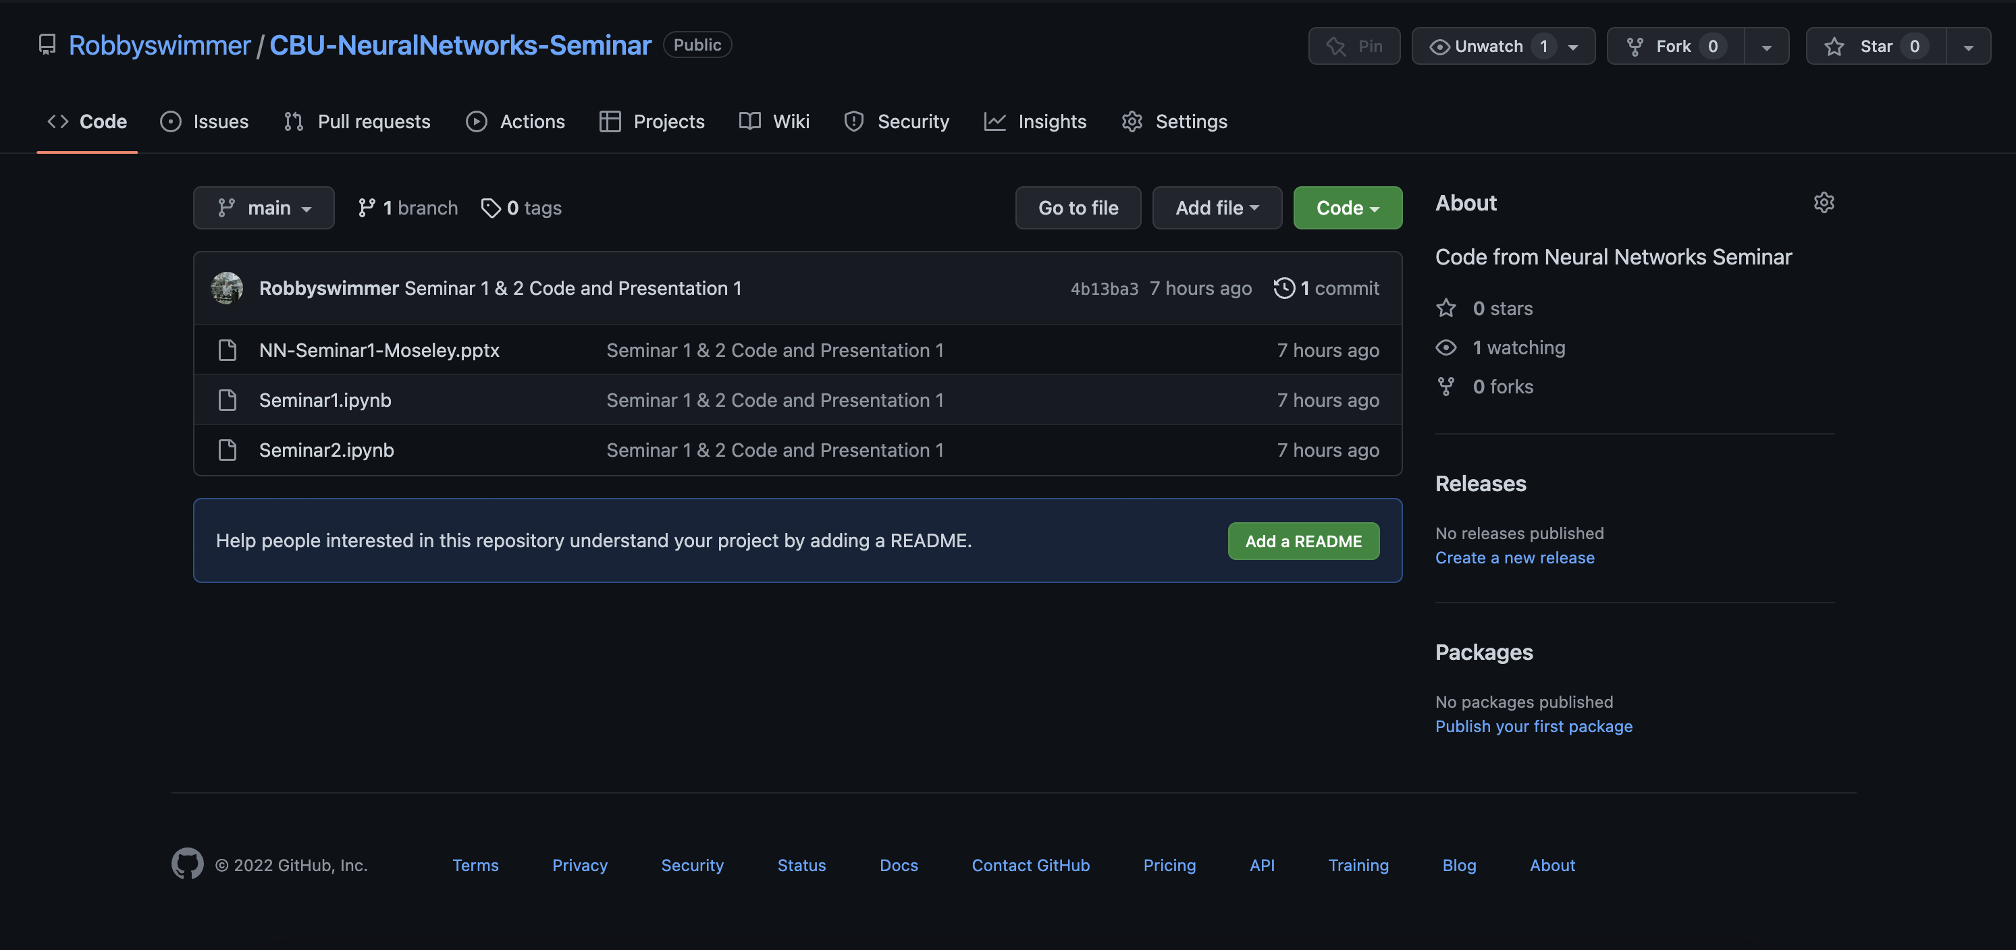
Github Link: https://github.com/Robbyswimmer/CBU-NeuralNetworks-Seminar

Slide 4
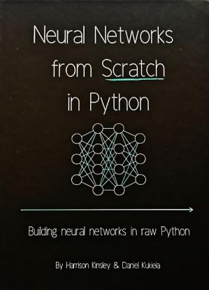
Materials for following along…
How to Follow Along:
Use any laptop
Python 3.7 or later
Numpy v1.15.0 or later
No Experience required
Book we will be learning from:
- Neural Networks from Scratch in Python (Harrison Kinsley & Daniel Kukiela)

Slide 5
Big Picture for Today
What is the main idea behind optimization? Can we randomly set weights and biases?
How can we change the outputs of the neurons?
How do we know if our neural network is working or not?

Slide 6
Review…

Slide 7
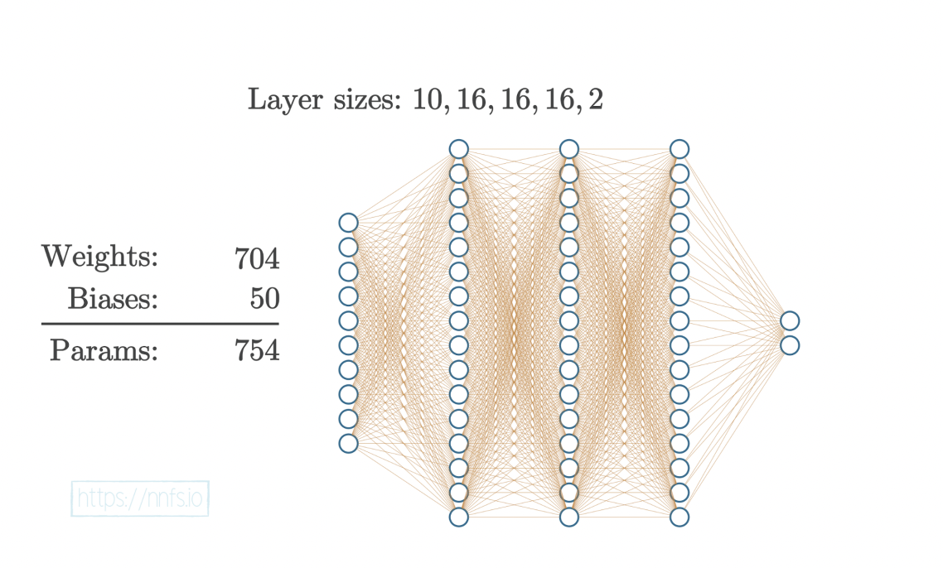
Neural Network Structure is inspired by the Brain
They are comprised of layers upon layers of individual neurons where each neuron has the responsibility of communicating a signal to the rest of the network
Notes:
Neural networks have different layer types:
1) Input layers
2) Hidden layers
3) Output layers
Input layers is where data starts out in a neural network – it is given in its raw, unfiltered form before the network manipulates it
Hidden layers are inaccessible to the creator of the network – these layers are responsible for parsing the input data and manipulating it until the data makes sense
Output layers are where the perceived answer generated by the network is actually read from
If you are performing classification, say dogs and cats, then one neuron represents that the network thinks it found a dog, and the second neuron represents that it thinks it found a cat
This network featured above represents what we would call a fully connected neural network because each node in one layer is connected to every node in the previous and subsequent node layers. The output of each node, becomes the input for its connecting node until the output layer is reached.
There are many different types of neural networks including recursive neural networks (which is best used for time series data), convolutional neural networks (best used on images and videos – think Tesla self-driving cars), Long Short-Term Memory (LSTM) which are great at shorting long sequences of data
We will focus on simpler neural networks, like the one featured in this picture, to keep explanations a little bit simpler

Slide 8
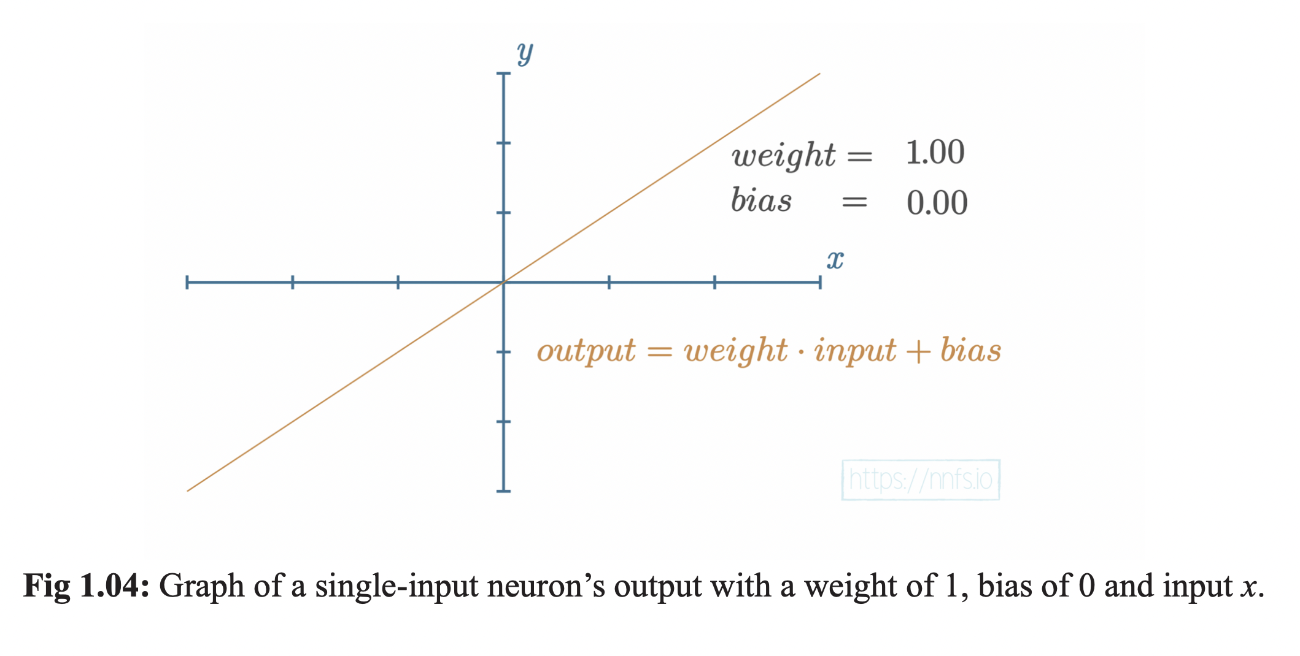
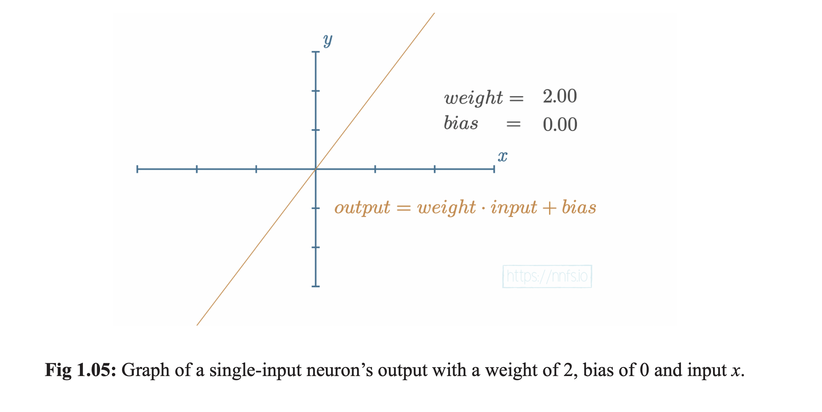
Notes:
Neurons are just numbers!
They are composed of weight and bias and training a neural network is basically just the process of changing these numbers
using mathematical functions
As you increase the value of the weight, the slope will simply get steeper. If the weight is decreased, the slope will decrease
Similarly, if the weight is negated the slope will turn negative!

Slide 9
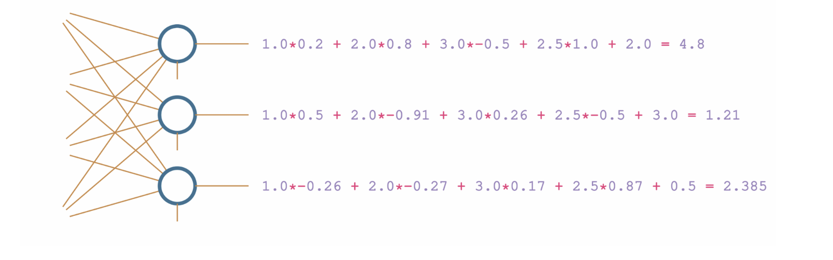
Summary of Neuron Layer created in first lesson

Slide 10
Activation Function Summary:
Activation functions are applied to neuron output
If we use a nonlinear activation function, it will create hidden layers that adapt to nonlinear functions
There are two types you need to know: 1) hidden layer activations, and 2) output activations
Mimics the binary output of an actual neuron (on or off)

Slide 11

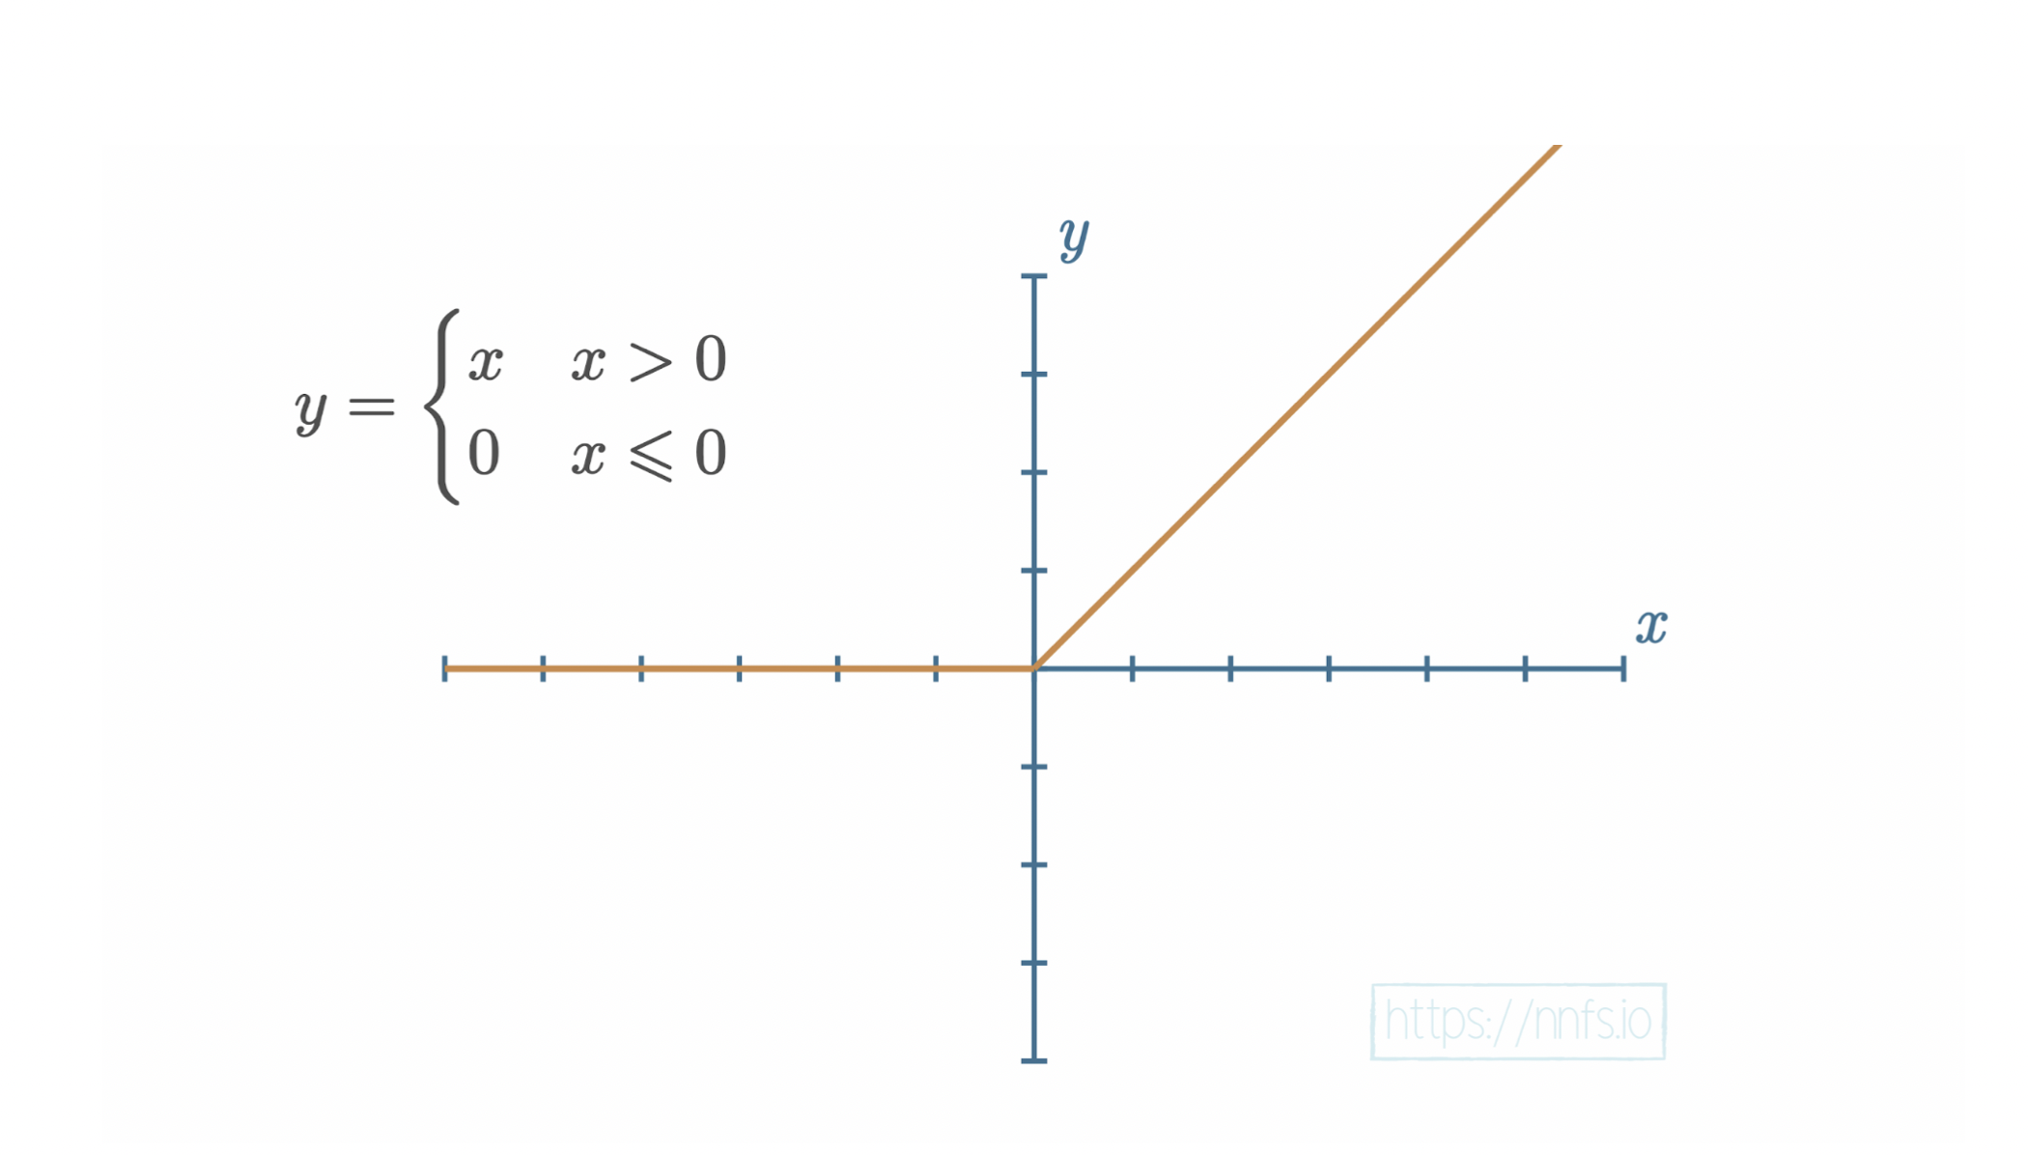
The most important, ReLU (Rectified Linear Unit) Activation function
Notes:
This function returns a 0 for values less than 0, and a linear output for values greater than 0 (y = x)
It is simpler than sigmoid, easier to calculate, and is currently the most popular activation function used by machine learning engineers and data scientists
It is as close to being linear as possible, without actually being linear (due to values less than 0 being treated as 0)
While Sigmoid is not difficult to compute, the time savings of ReLU really add up when it is being computed millions or billions of times to train a model

Slide 12
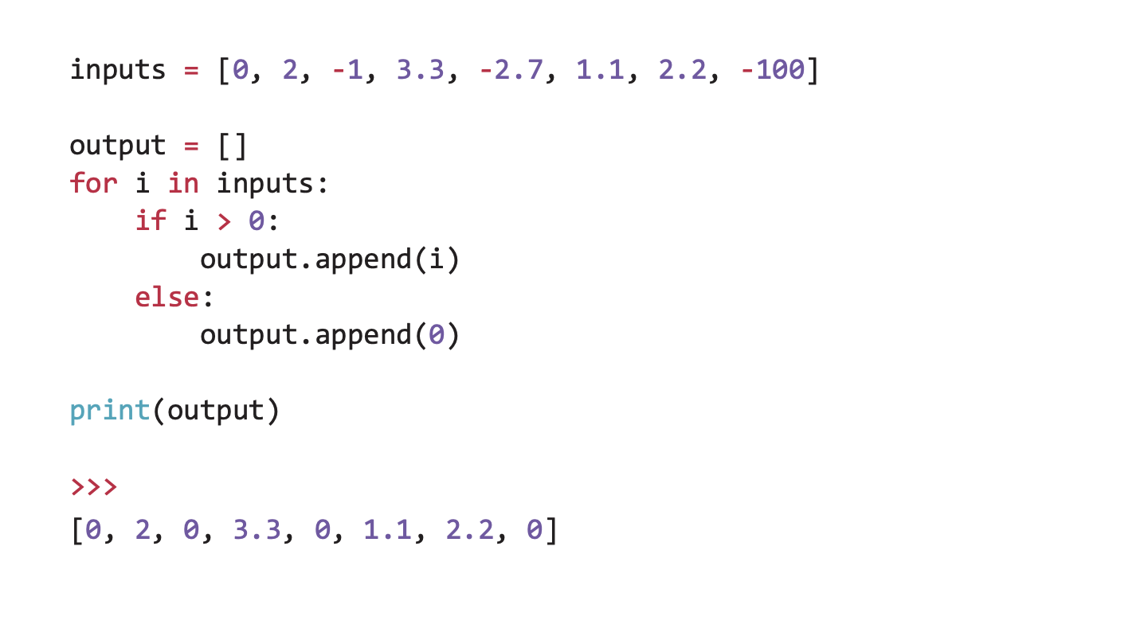
Despite the scary name…
Notes:
ReLU is actually (maybe obviously) very easy to implement and use in our code!
It’s basically just an if statement that checks if the value is greater than 0

Slide 13
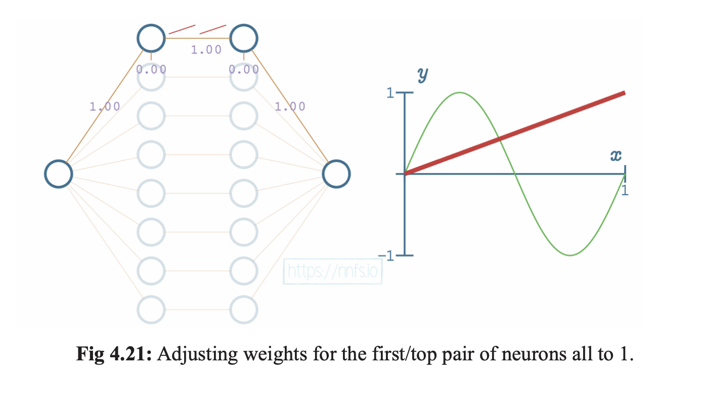
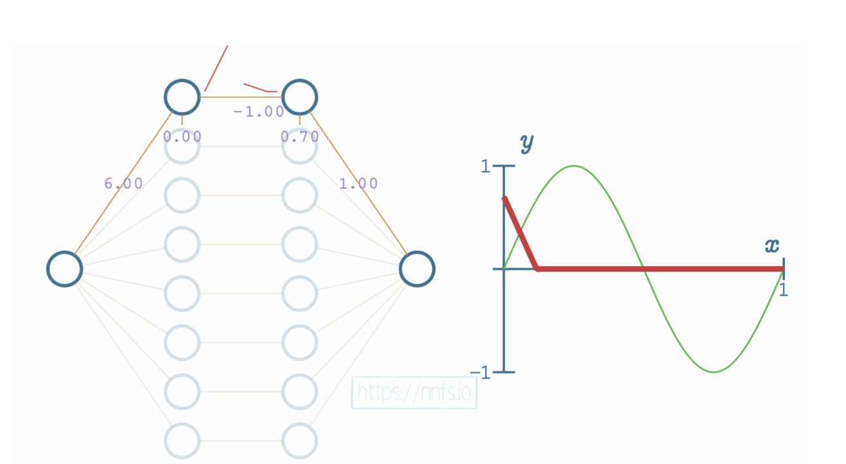
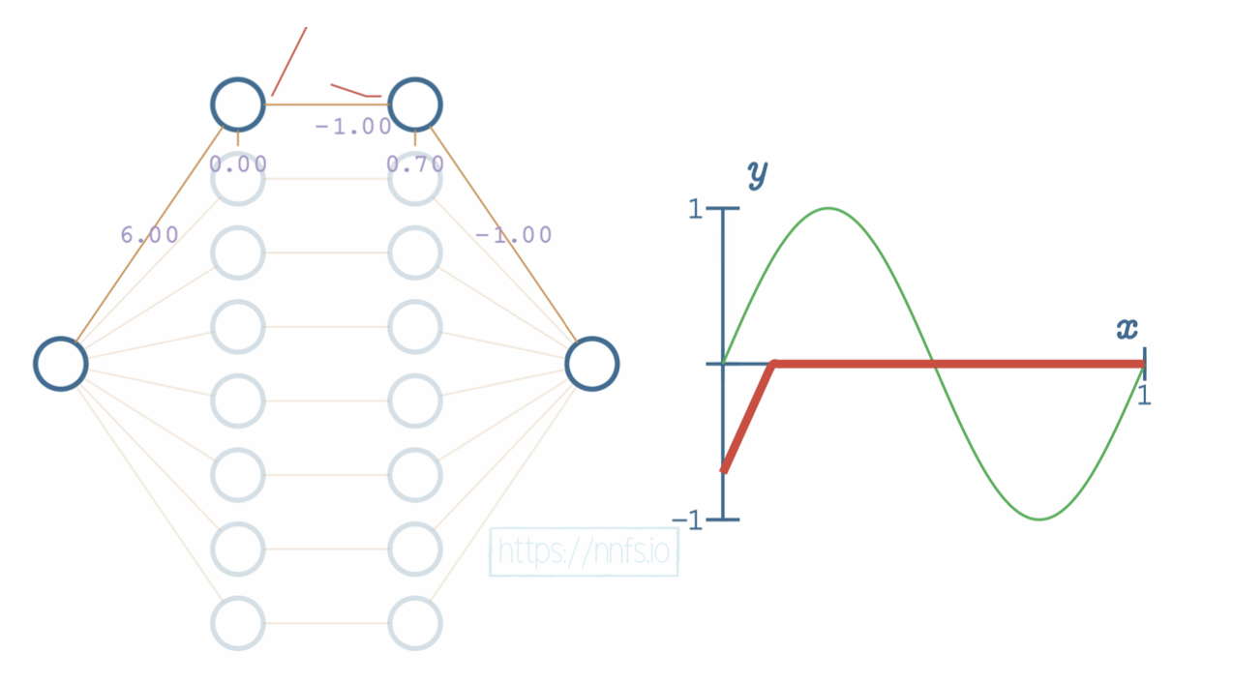
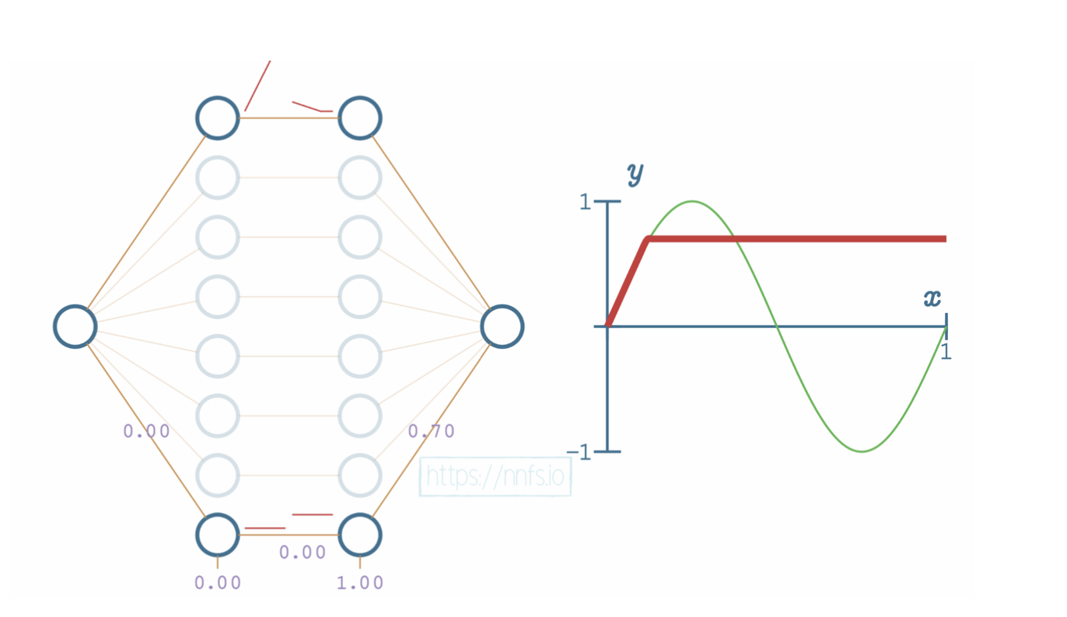
Notes:
Bit by bit, as we are training the function, we can adjust the output of our neurons to match the input labels

Slide 14
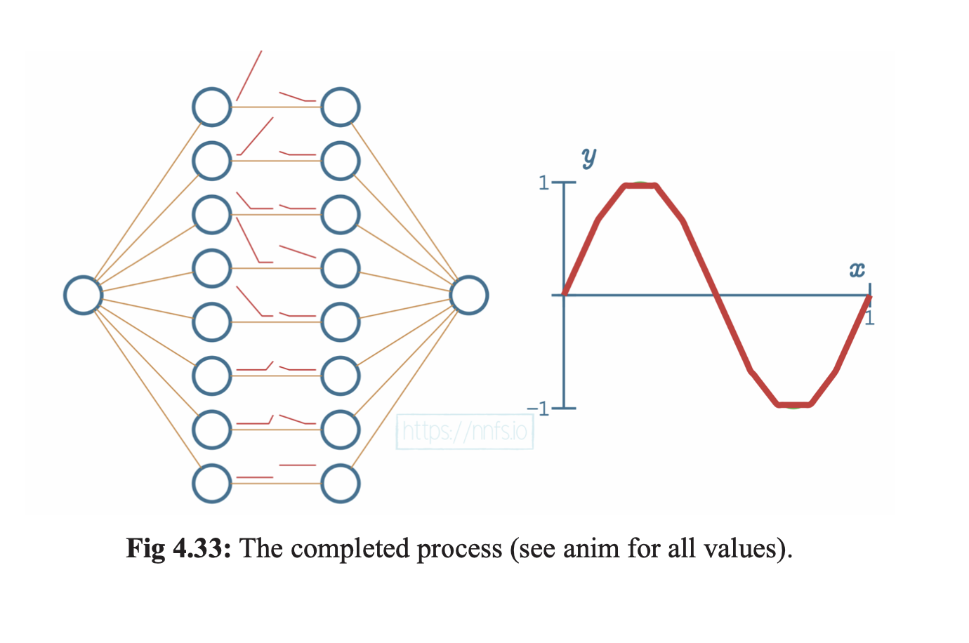
Notes:
The process from the previous slide is repeated for every neuron, and eventually we can fit y = sin(x)

Slide 15
Important IDEA:
ReLU is great for training a network – but it does not work on the output layer!
A different function is needed for the output layers that can allow us to understand what the network is “thinking”

Slide 16
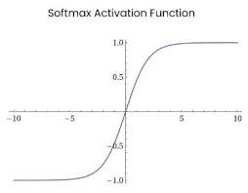
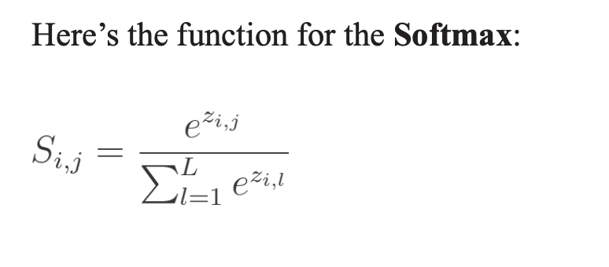
One Final Activation Function…
Notes:
What you need to know about Softmax is that it works on the output layer and through it’s equation creates a probability distribution.
Each output neuron in the final layer of the neural network represents a prediction, softmax will help us determine which prediction the network thinks is most likely.

Slide 17
What is Loss?
In order to train a model, we need to know if the model is accurate or not
01
To calculate the error of the model we use a technique called calculating network loss (it tells us how wrong or right the network is)
02
To calculate loss we first need a loss function that can tell us how far off the network is from the correct values
03

Slide 18
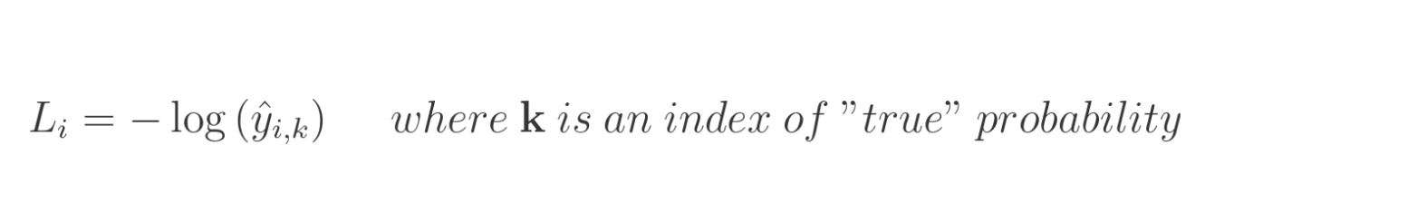
Categorical Cross Entropy Loss
Notes:
There are lots of different loss functions that you can learn and use, but we will only focus on categorical cross entropy loss to keep things a little more simple
Categorical cross entropy is great for models that use softmax as their final layer (normal for classification models)
CCE is also incredibly common as a loss function, and it is very simple to implement
In the above equation, L-sub i denotes sample loss value, i is the i-th sample of the data set, and k is the index of the label that corresponds to i-th sample
Finally, y-hat denotes the predicted value

Slide 19
Summary of Seminar 2
We reviewed our work from the previous session one creating individual neurons
We learned how to stack neurons into usable layers
We learned about activation functions and about how ReLU can be used to approximate complex functions (think about the Sine wave example)
We finished by discussing loss functions and how they can be used to figure out the error of our network which will help us train it better in the future!

Slide 20

Questions?

Slide 21
Optimizing Our Neural NEtwork

Slide 22
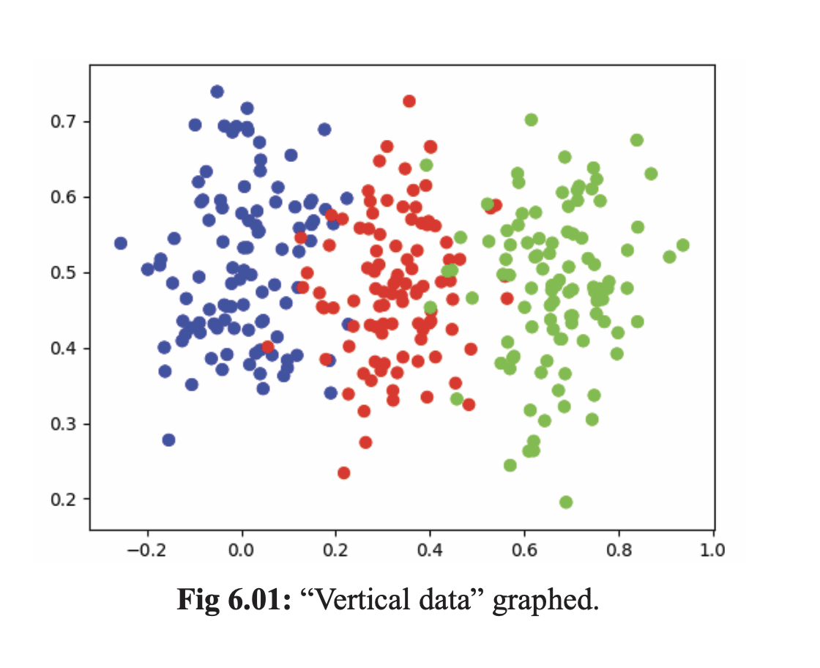
Network training is Just Changing the Weights and Biases Overtime until the best result is achieved!
Notes:
If we wanted to train a network to fit this data, we would simply need to change the values of our weights and biases until the network was correctly separating data points like we want it to!

Slide 23
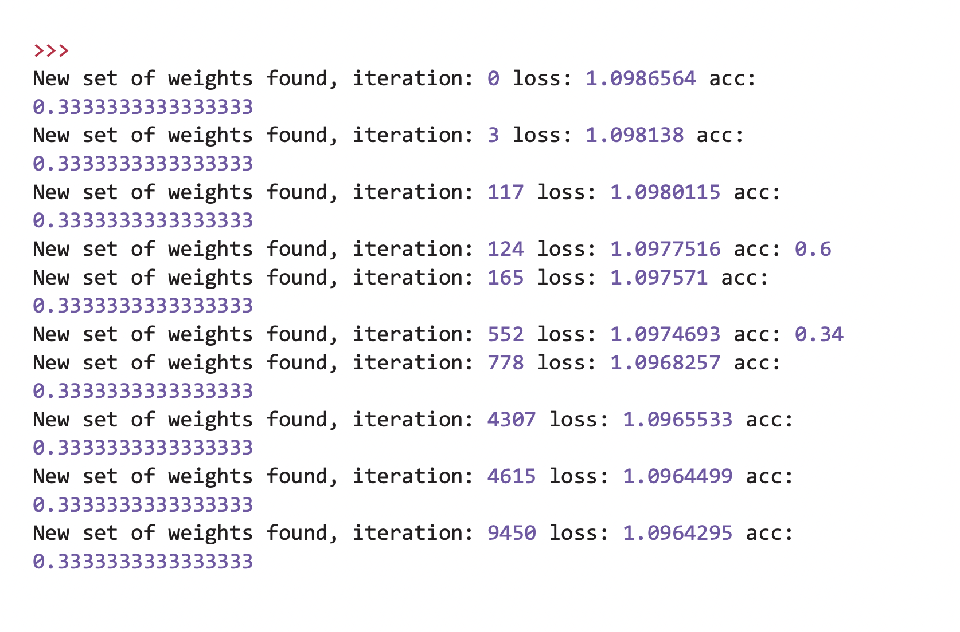
Can we just randomly Change Values to Train our Network?
Notes:
Well, we technically can…. But it might take years to achieve a good result!
Especially when our dataset becomes even a little bit complex, randomly optimizing the network does not help almost at all!

Slide 24
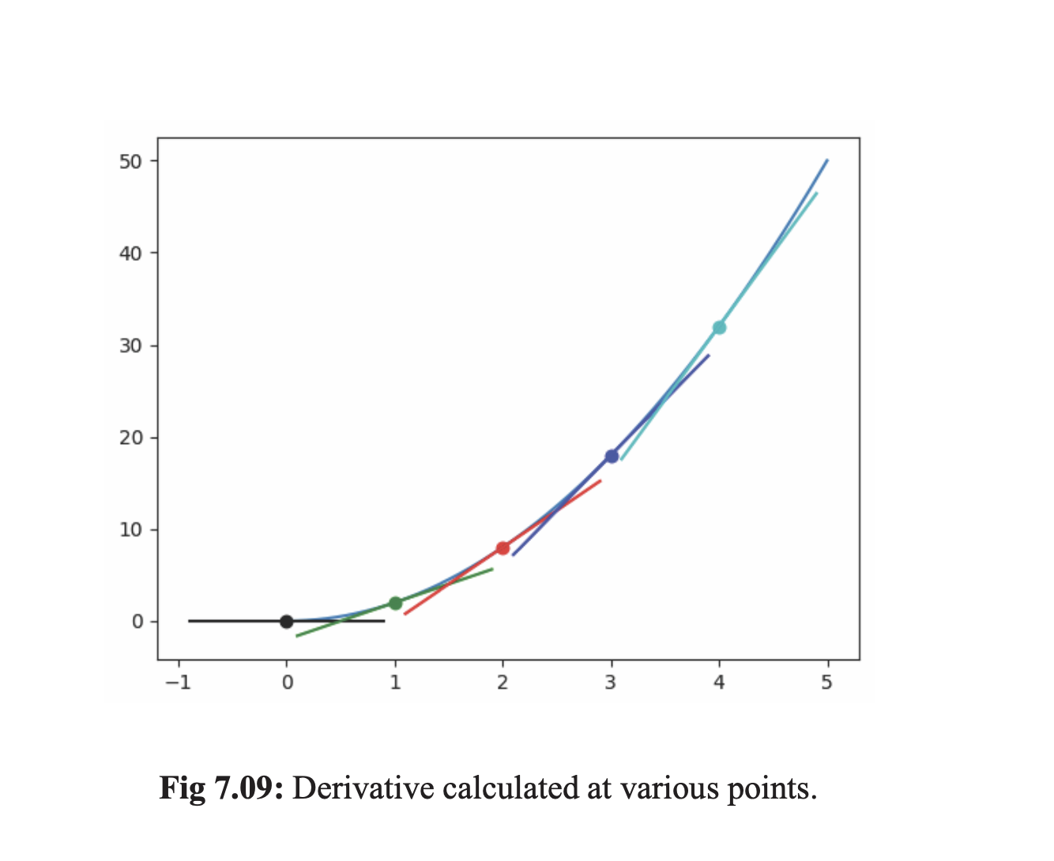
We can train our networks much better using derivatives (just the slope of the tangent line of any point in our function)

Slide 25
Backpropagation

Slide 26
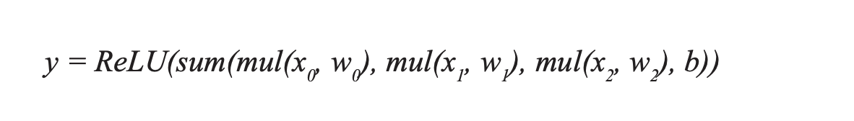
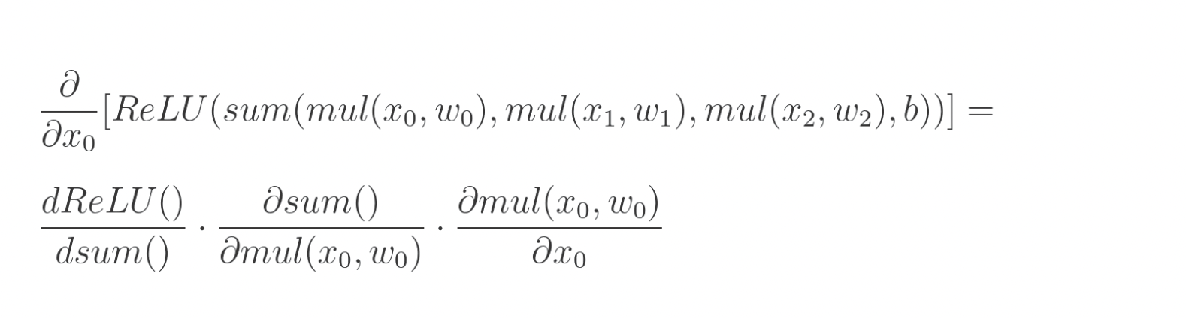
Backpropagation for a Single Neuron:
Notes:
The equation we are calculating when we do this is really just 3 different nested equations:
- 1) ReLU
- 2) Sum of weighted inputs and the associated bias
3) The multiplications of inputs and their weights
To calculate back propagation, we are basically just taking partial derivatives of the nested functions
The output of these partial derivatives is the amount that the previous neuron has on the output of our neural network
Eventually we will have layers of deeply connected neurons with an associated loss function.
We will also have to calculate the derivative of our loss function so that it can also be optimized.

Slide 27
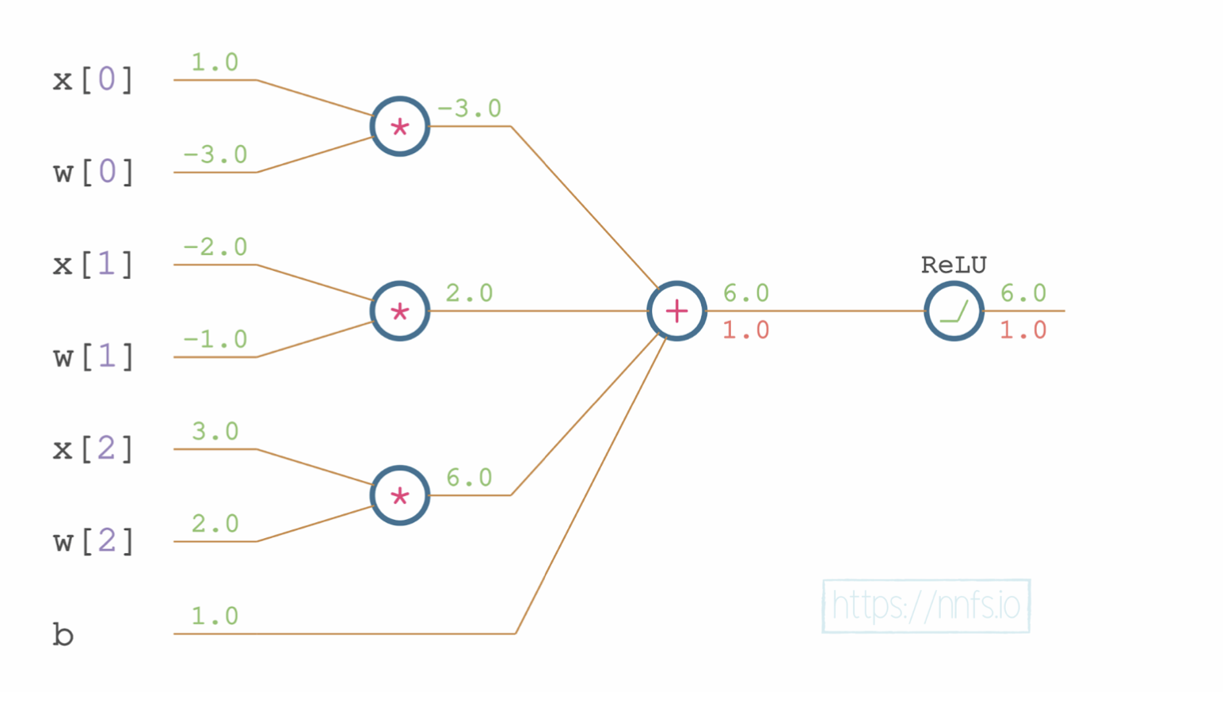
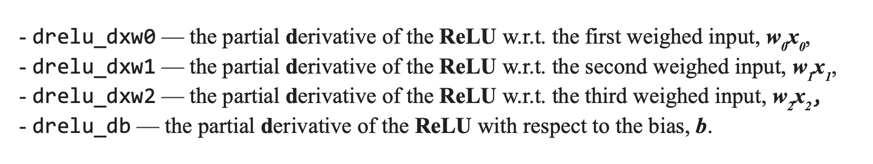
Partial Derivatives of Neurons:
Notes:
On the left is an example of the network that we might be calculating the partial derivatives of
Every partial derivative in this instance is done with respect to the output of ReLU because it is the output function of the neuron we are performing back propagation on
Notably, in a normal neural network we would expect to have a lot more partial derivatives than this – this is just a small neural network
But this is basically the equation on the previous slide, but demonstrated visually so you can see where the partial derivatives are coming from

Slide 28
Stochastic Gradient Descent

Slide 29
What is Stochastic Gradient Descent?
Stochastic Gradient Descent is just an optimizer for your neural network
SGD uses something called learning rate that decides how dramatically the optimizer should make changes to your network every time it sees a batch of data
The higher the learning rate, the faster your network could learn, but it might also get stuck (which we will talk about in just a few minutes)
The backpropagation we were doing before is a form of SGD
Notes:
Historically, SGD is an optimizer that fits to a single sample at a time (many newer optimizers will fit optimizers to batches of data that allow them to create more intelligent, and faster back propagation algorithms
Stochastic gradient uses something called learning rate

Slide 30
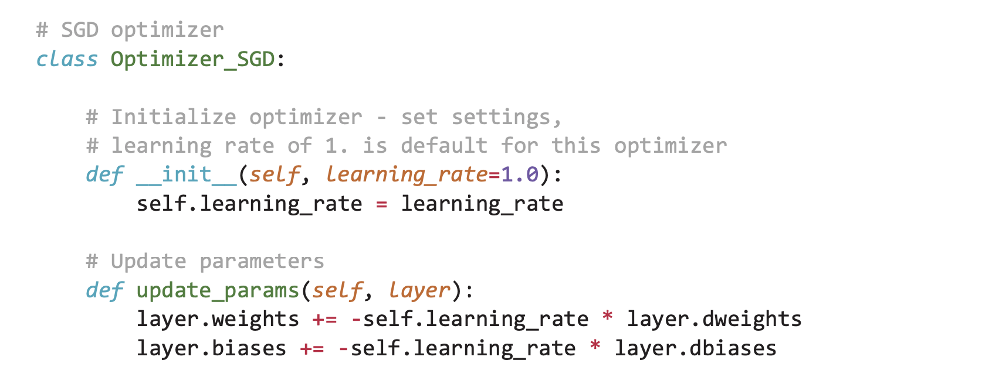
Code for SGD (simple)
Notes:
As you can see from this code, the learning rate of your network is initialized at the beginning of training, and that number is used throughout the training process to help the network decide how much it should be adjusting the weights and the biases in the network
By calling this on each layer of the network we can either decide to ”train” the network quickly by making big changes to the weights and biases, or we can ”train” slowly by making minor adjustments to the weights and biases

Slide 31
Learning Rate

Slide 32
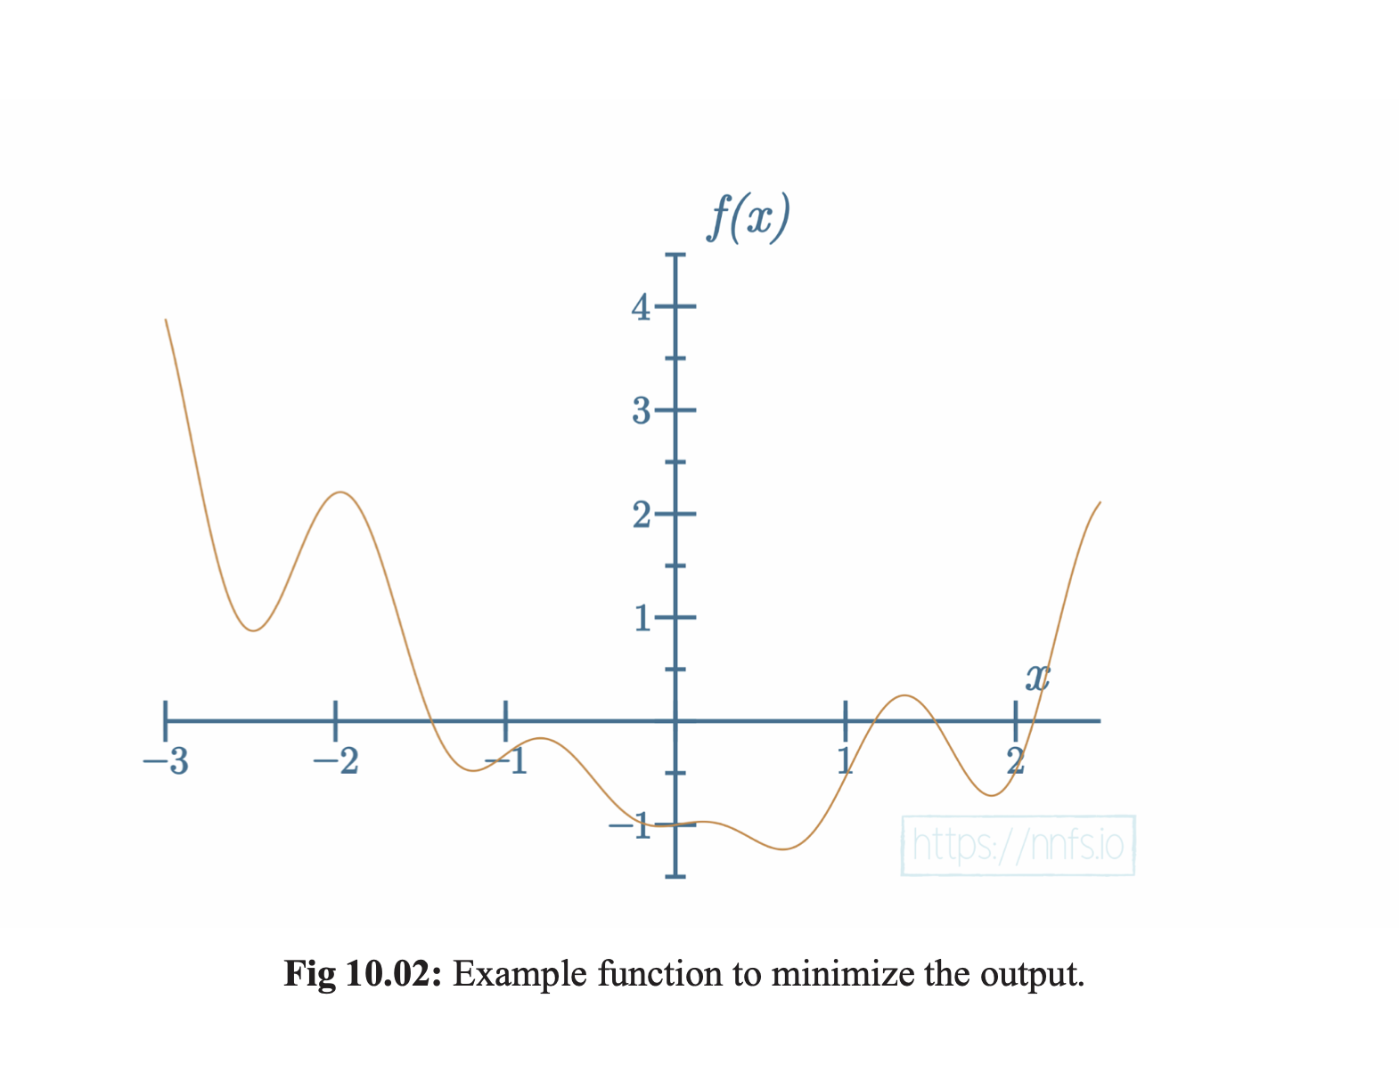
Example of a function that we can minimize using the right learning rate
Notes:
The best possible output of our neural network – i.e. when it performs the best is given by something called the global minimum
The global minimum is simply the lowest point of the function
The problem is that it is not always easy for our model to find that point of our function

Slide 33
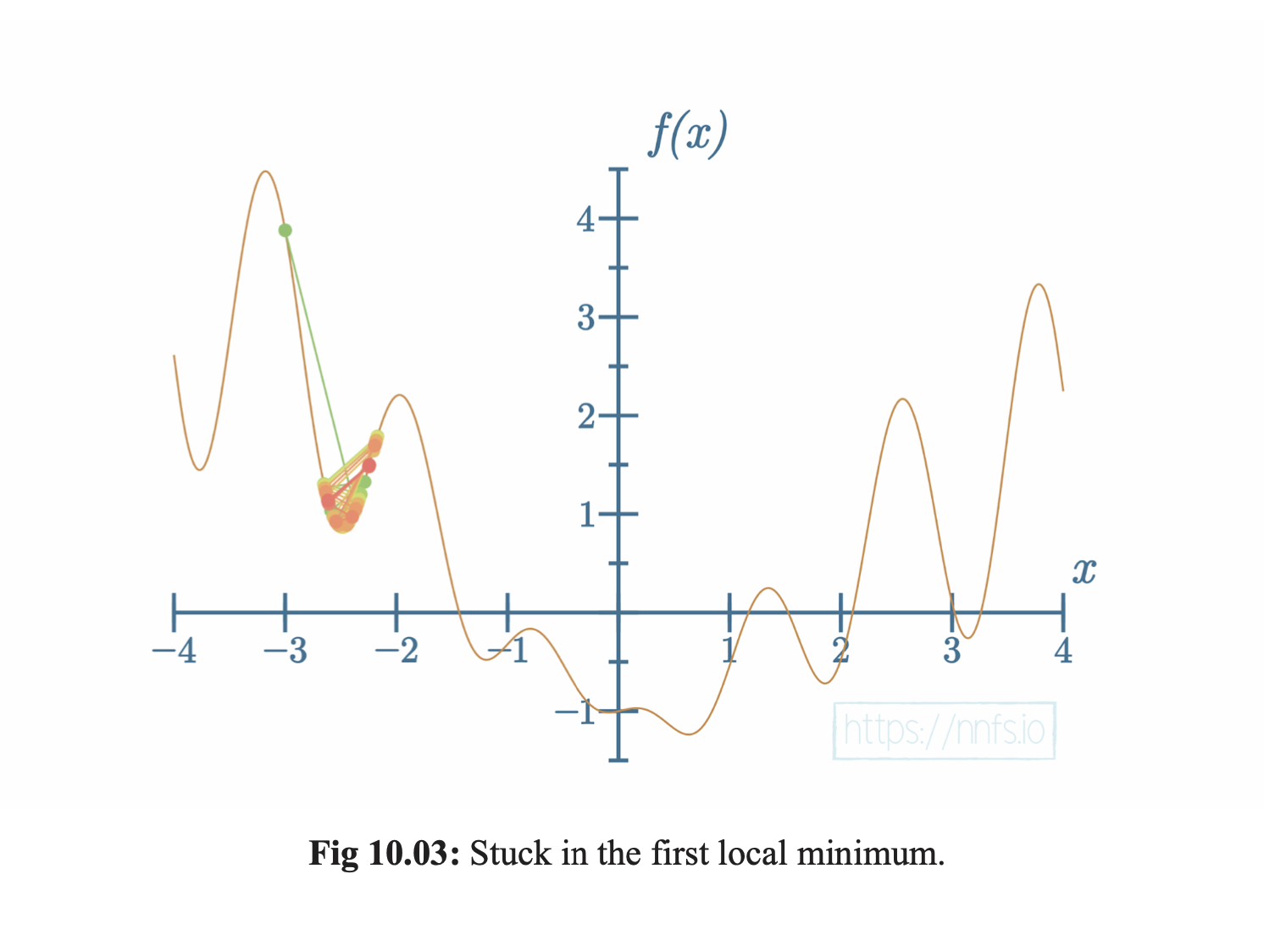
The problems with too high of a learning Rate
Get stuck in local minima

Slide 34
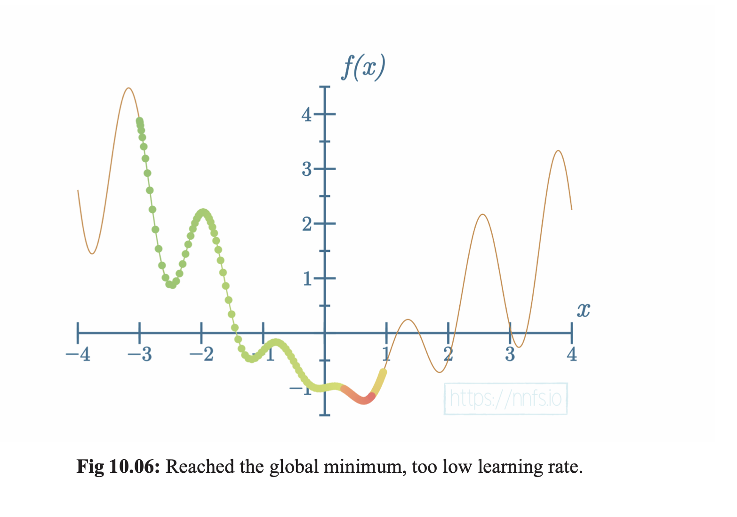
If our Learning rate is too small it will take too long to reach our global minimum!

Slide 35
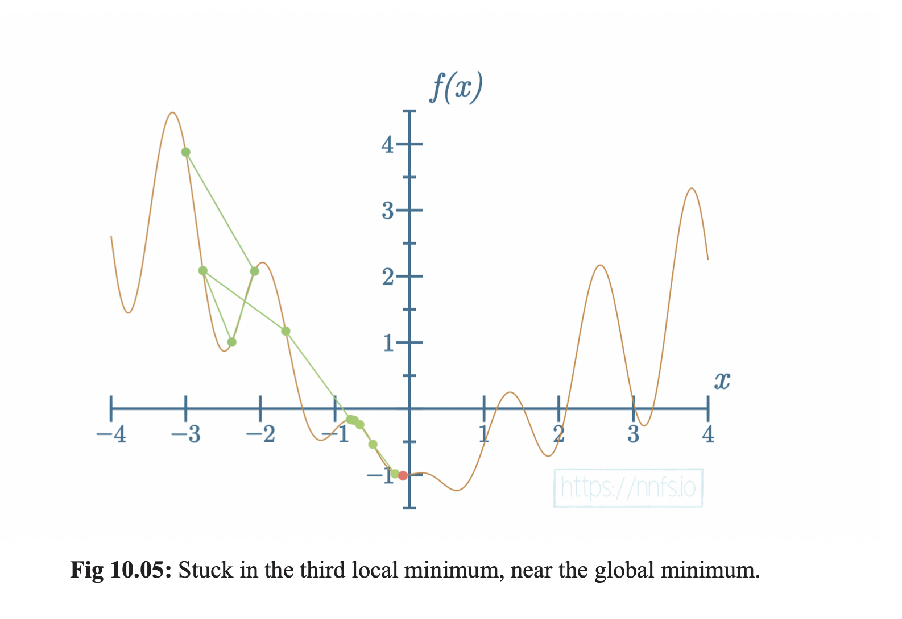
Optimizing the learning rate is important! It’s about balance and experimentation

Slide 36
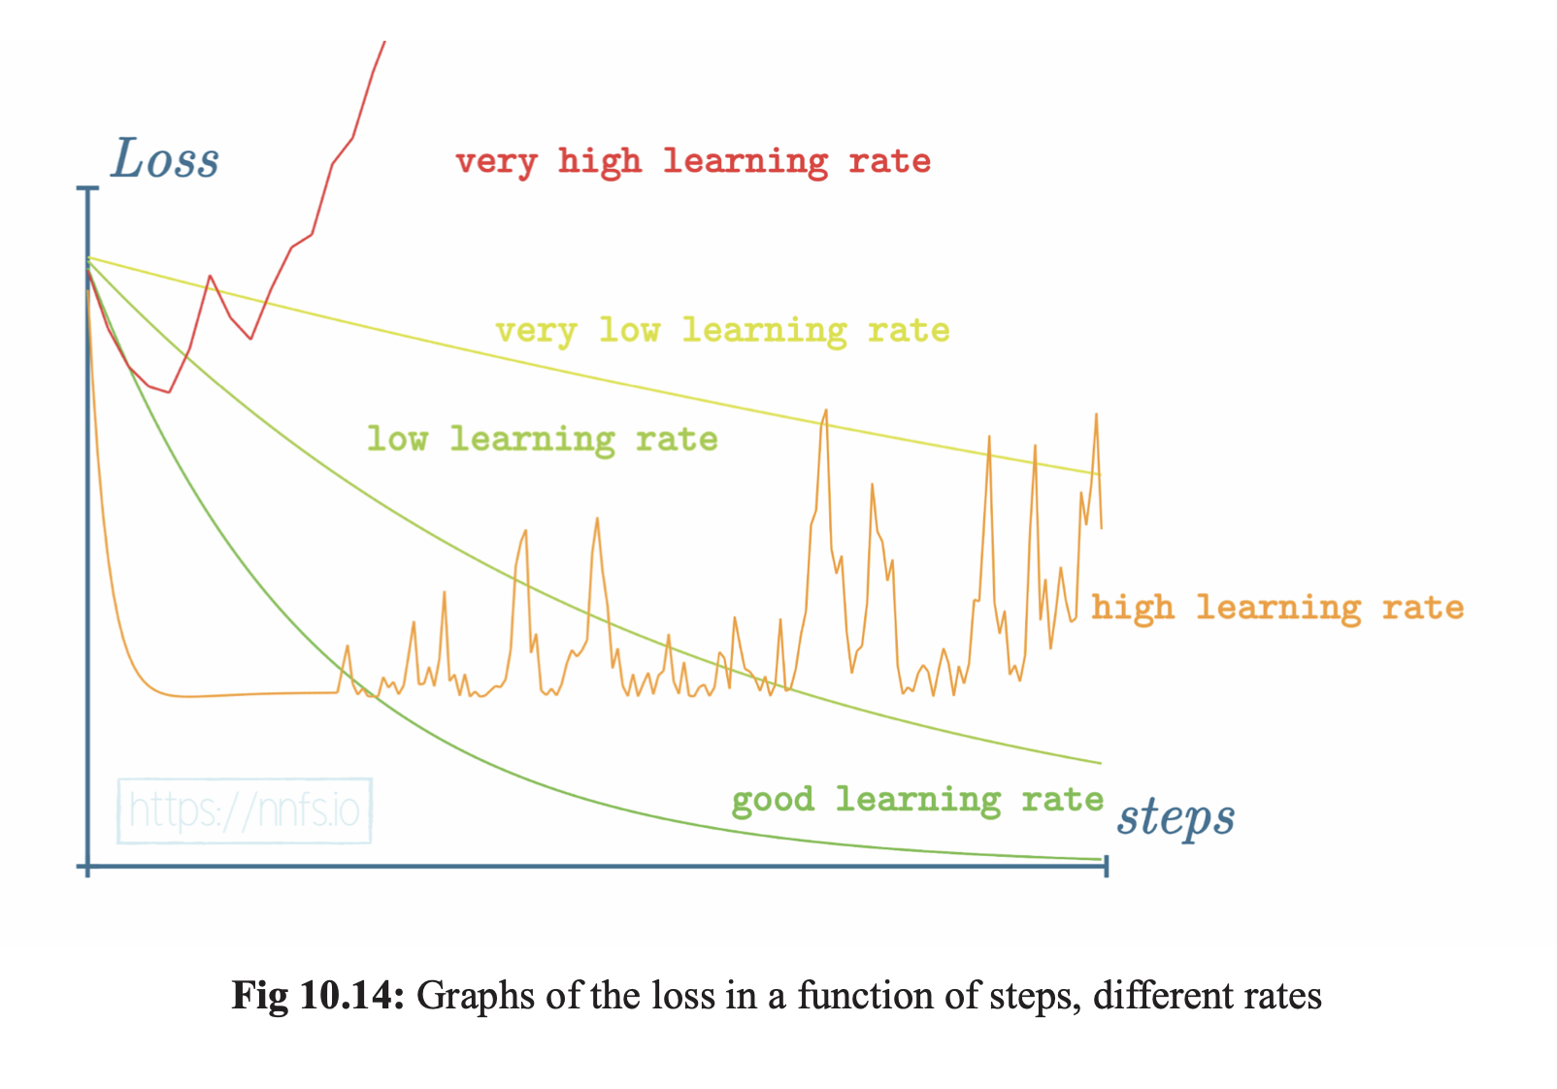
Picking Hyperparameters

Slide 37

CODE Backpropagation

Slide 38

Thank you

